Slide 1
18CSE390T
Computer Vision
S3-SLO2-Level Sets

Slide 2
Level Sets
A limitation of active contours based on parametric curves of the form f(s) (snakes, b-snakes,…) is that it is challenging to change the topology of the curve as it evolves.
If the shape changes dramatically, curve reparameterization may also be required.
An alternative representation for such closed contours is to use level sets (LS).
– LS evolve to fit and track objects of interest by modifying the underlying embedding function instead of curve function f(s)

Slide 3
Image Segmentation with Level Sets
Contour evolution (Sethian and Osher, 1988)
Level sets for closed contours
  Zero-crossing(s) of a characteristic function define the curve
  Fit and track objects of interest by modifying the underlying embedding function ^{(x, y)} instead of the curve f(s)
  Efficient algorithm
    A small strip around the locations of the current zero-crossing needs to updated at each step

Slide 4
Moving Interfaces
2D Moving Curves
3D Moving Surfaces
Interfaces between water and oil
Propagating front of bush fire
Deformable elastic solid

Slide 5
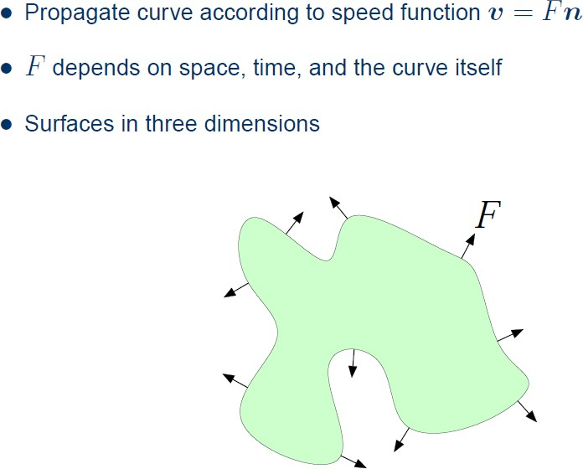
Evolving Curves and Surfaces

Slide 6
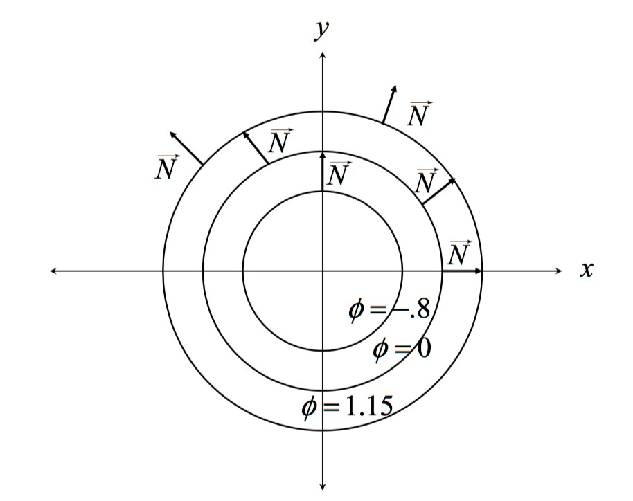
Describe curve as Level Sets of a Function
$(x, y) = x² + y² — 1 = 0

Slide 7
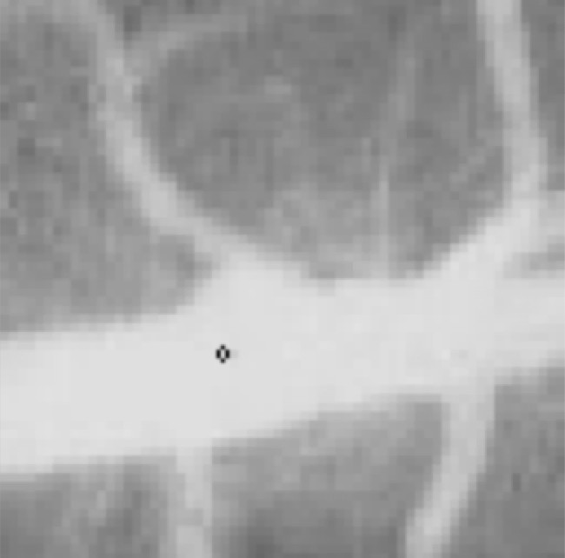
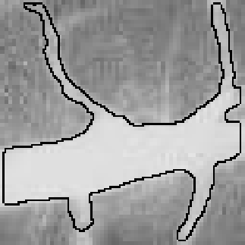
Vein Segmentation with Level Set

